Slide 1
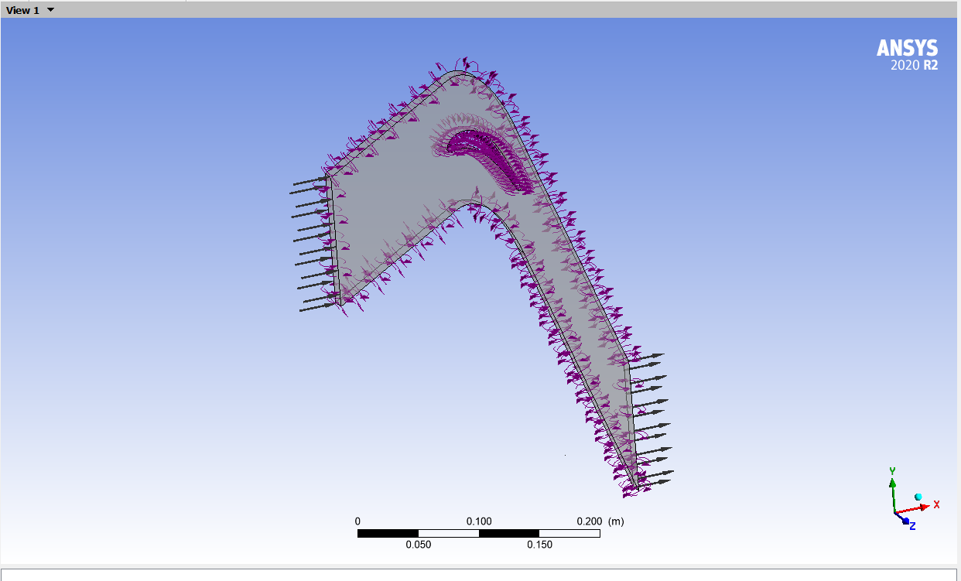
Blade Condition T_{s (}290K), and No –slip Condition
P_{01,} (288Kpa), T₁(415K), Inlet Flow angle
Periodic BC
Hub & Tip Slip wall and Also Periodic BC
P_{02 Average Static Pressure,} (165.5 Kpa)

